Slide 1


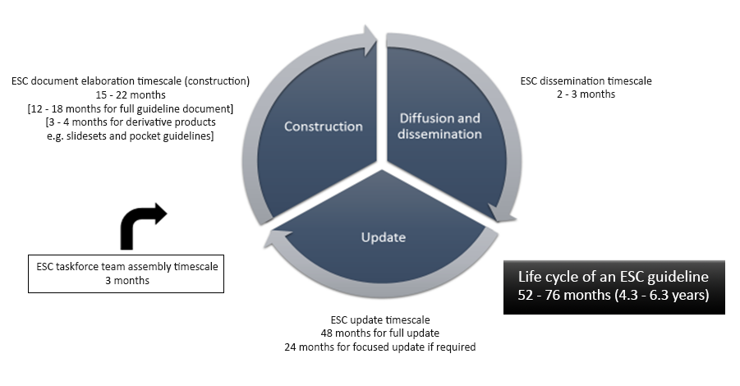

A compendium of international guidelines for interventional practice
Figure 1
Life-cycle of European Cardiovascular Guidelines.
Mark Davies
©2025 Europa Group - All rights reserved.

