Slide 1


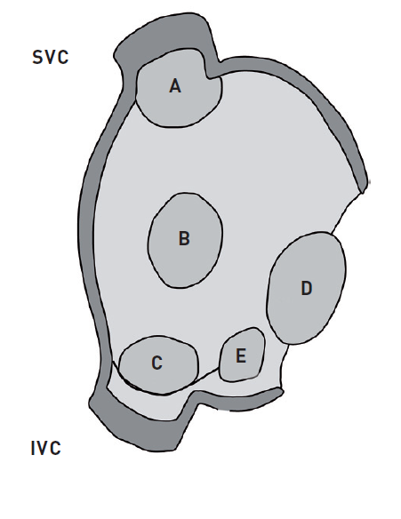
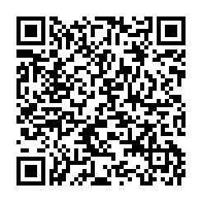
Atrial septal defect and patent foramen ovale closure
Figure 1
Different types of atrial septal defectsSVC (superior vena cava), IVC (inferior vena cava), A (superior sinus venosus defect), B (secundum ASD), C (inferior sinus venosus defect), D (primum ASD), E (coronary sinus ASD).
Jochen Wöhrle, Julia Seeger
©2025 Europa Group - All rights reserved.

