Slide 1


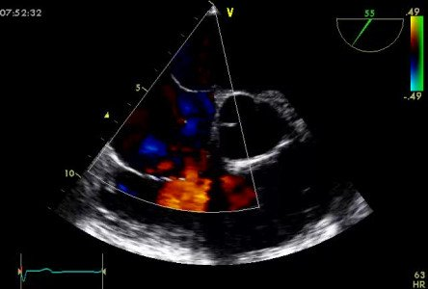
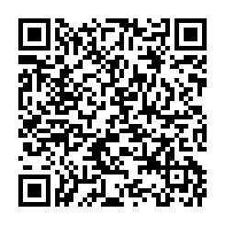
Atrial septal defect and patent foramen ovale closure
MOVING IMAGE 1-1
TEE with Colour Doppler showing the LR shunt of a secundum ASD.
Jochen Wöhrle, Julia Seeger
©2025 Europa Group - All rights reserved.

