Slide 1


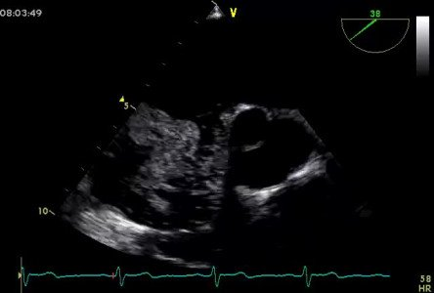

Atrial septal defect and patent foramen ovale closure
MOVING IMAGE 1-2
Administration of bubble nicely demonstrates the LR shunt and an intermittent passage of bubbles from RA to LA.
Jochen Wöhrle, Julia Seeger
©2025 Europa Group - All rights reserved.

