Slide 1


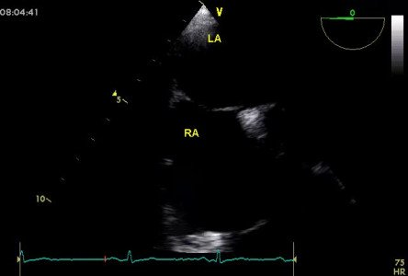
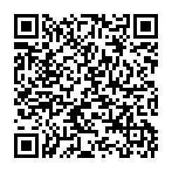
Atrial septal defect and patent foramen ovale closure
MOVING IMAGE 10-1
TEE with PFO.
Jochen Wöhrle, Julia Seeger
©2025 Europa Group - All rights reserved.

