Slide 1


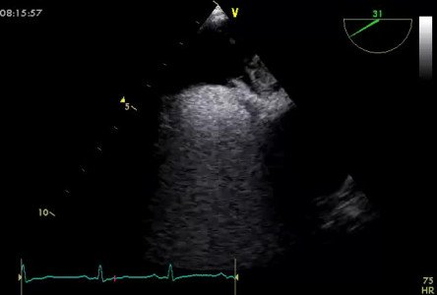

Atrial septal defect and patent foramen ovale closure
MOVING IMAGE 10-2
Severe bubble passage through the PFO documented in TEE.
Jochen Wöhrle, Julia Seeger
©2025 Europa Group - All rights reserved.

