Slide 1


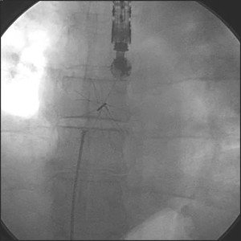

Atrial septal defect and patent foramen ovale closure
MOVING IMAGE 10-3
Release of a first-generation device with stiff wires. Note the shift in final position after the forceps is opened.
Jochen Wöhrle, Julia Seeger
©2025 Europa Group - All rights reserved.

