Slide 1


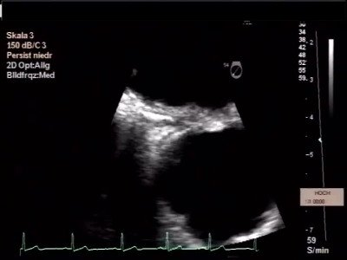

Atrial septal defect and patent foramen ovale closure
MOVING IMAGE 10-4
Routine 3 months TEE demonstrates the perforation of one of the stiff wires into the aortic wall.
Jochen Wöhrle, Julia Seeger
©2025 Europa Group - All rights reserved.

