Slide 1


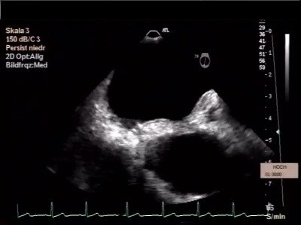

Atrial septal defect and patent foramen ovale closure
MOVING IMAGE 10-5
Intramural haematoma around the perforated wire in the aortic wall.
Jochen Wöhrle, Julia Seeger
©2025 Europa Group - All rights reserved.

