Slide 1


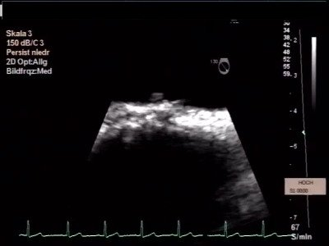

Atrial septal defect and patent foramen ovale closure
MOVING IMAGE 10-6
Further TEE evaluation demonstrates a small thrombus attached to the LA disc. The occluder was surgically removed.
Jochen Wöhrle, Julia Seeger
©2025 Europa Group - All rights reserved.

