Slide 1


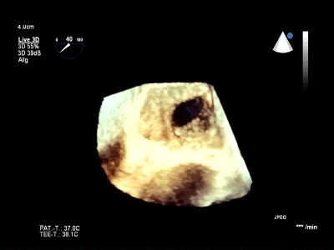

Atrial septal defect and patent foramen ovale closure
MOVING IMAGE 2
Diagnosis of ASD. 3D TEE imaging demonstrates a typical secundum ASD with sufficient rims for percutaneous ASD closure.
Jochen Wöhrle, Julia Seeger
©2025 Europa Group - All rights reserved.

