Slide 1


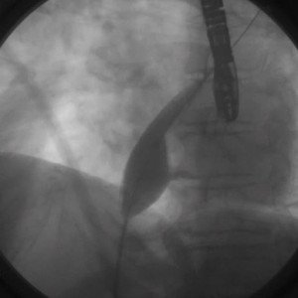

Atrial septal defect and patent foramen ovale closure
MOVING IMAGE 3-1
Sizing of ASD with stop-flow technique.
Jochen Wöhrle, Julia Seeger
©2025 Europa Group - All rights reserved.

