Slide 1


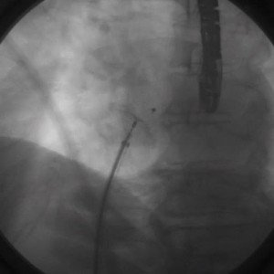

Atrial septal defect and patent foramen ovale closure
MOVING IMAGE 3-2
Release of the device after delivery of LA and RA disc. Note the shift in the final position.
Jochen Wöhrle, Julia Seeger
©2025 Europa Group - All rights reserved.

