Slide 1


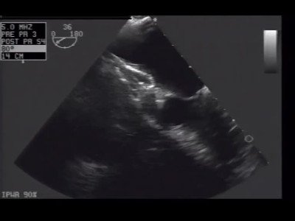

Atrial septal defect and patent foramen ovale closure
MOVING IMAGE 4-1
Device embolisation in LV of an Amplatzer ASD Occluder after unscrewing from the delivery cable.
Jochen Wöhrle, Julia Seeger
©2025 Europa Group - All rights reserved.

