Slide 1


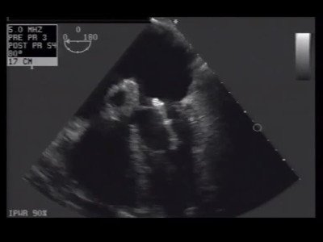

Atrial septal defect and patent foramen ovale closure
MOVING IMAGE 4-2
The device embolised to the mitral valve between the papillary muscles.
Jochen Wöhrle, Julia Seeger
©2025 Europa Group - All rights reserved.

