Slide 1


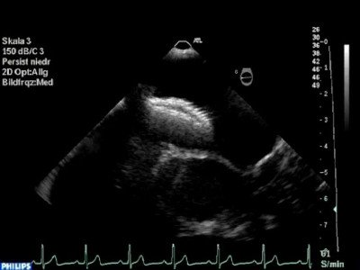

Atrial septal defect and patent foramen ovale closure
MOVING IMAGE 5
Device dislocation. Dislocation of an Amplatzer ASD Occluder after release from the delivery cable. The device is dislocated at the aortic rim.
Jochen Wöhrle, Julia Seeger
©2025 Europa Group - All rights reserved.

