Slide 1


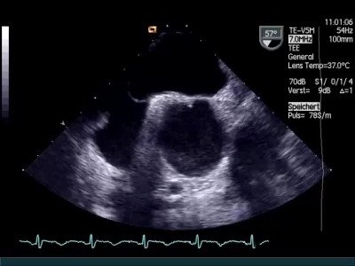

Atrial septal defect and patent foramen ovale closure
MOVING IMAGE 6-1
TEE of a PFO with proper Valsalva manoeuvre. The atrial septum shifts from RA to LA resulting in a funnel with wide opening of the PFO.
Jochen Wöhrle, Julia Seeger
©2025 Europa Group - All rights reserved.

