Slide 1


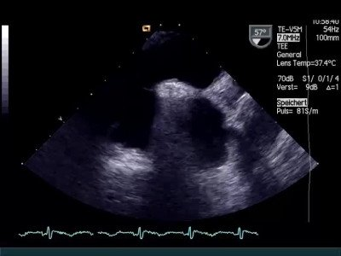
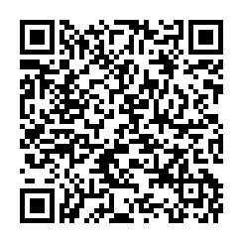
Atrial septal defect and patent foramen ovale closure
MOVING IMAGE 6-2
Same patient with bubble testing. Note the severe bubble passage during shift of the atrial septum in LA. Bubbles are nicely seen in LA and also in the cross-sectional view of the aorta.
Jochen Wöhrle, Julia Seeger
©2025 Europa Group - All rights reserved.

