Slide 1


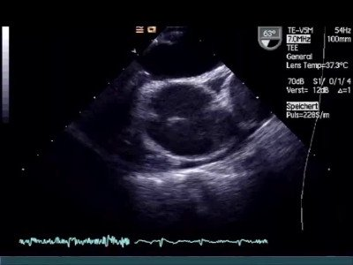

Atrial septal defect and patent foramen ovale closure
MOVING IMAGE 7-1
Bubble passage demonstrated in TEE in a patient with cryptogenic stroke.
Jochen Wöhrle, Julia Seeger
©2025 Europa Group - All rights reserved.

