Slide 1


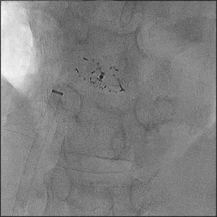
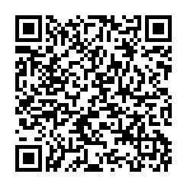
Atrial septal defect and patent foramen ovale closure
MOVING IMAGE 7-10
Angiographic documentation of correct position of the device. No residual shunting.
Jochen Wöhrle, Julia Seeger
©2025 Europa Group - All rights reserved.

