Slide 1


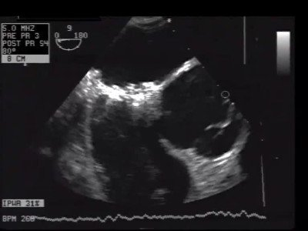
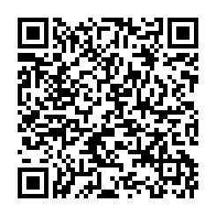
Atrial septal defect and patent foramen ovale closure
MOVING IMAGE 7-11
Bubble testing with TEE and Valsalva manoeuvre after device implantation. No bubbles are seen in LA or aorta.
Jochen Wöhrle, Julia Seeger
©2025 Europa Group - All rights reserved.

