Slide 1


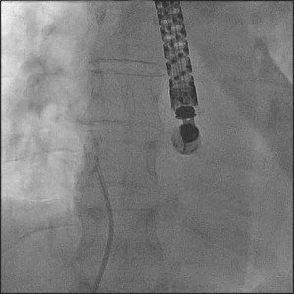
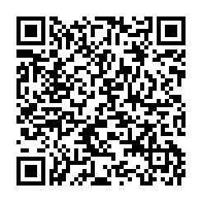
Atrial septal defect and patent foramen ovale closure
MOVING IMAGE 7-2
PFO occluder implantation was performed with TEE guidance. The PFO was passed with a wire in typical location.
Jochen Wöhrle, Julia Seeger
©2025 Europa Group - All rights reserved.

