Slide 1


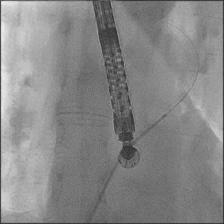

Atrial septal defect and patent foramen ovale closure
MOVING IMAGE 7-3
The multipurpose catheter was advanced in the LUPV over the guidewire.
Jochen Wöhrle, Julia Seeger
©2025 Europa Group - All rights reserved.

