Slide 1


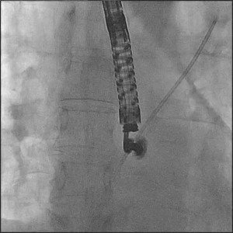

Atrial septal defect and patent foramen ovale closure
MOVING IMAGE 7-4
A stiff wire is advanced inside the multipurpose catheter in the LUPV.
Jochen Wöhrle, Julia Seeger
©2025 Europa Group - All rights reserved.

