Slide 1


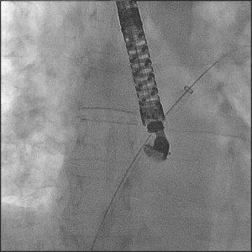
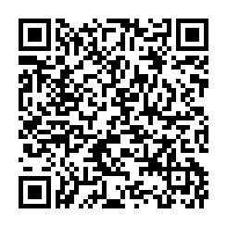
Atrial septal defect and patent foramen ovale closure
MOVING IMAGE 7-5
The delivery sheath was advanced over the stiff wire in LUPV. The dilator was already retrieved.
Jochen Wöhrle, Julia Seeger
©2025 Europa Group - All rights reserved.

