Slide 1


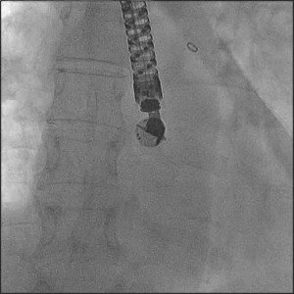

Atrial septal defect and patent foramen ovale closure
MOVING IMAGE 7-6
After careful backward bleeding and flushing of the delivery sheath the device (BioSTAR; NMT Medical, Boston, MA, USA) was advanced while the delivery sheath was kept in a stable position in the LUPV.
Jochen Wöhrle, Julia Seeger
©2025 Europa Group - All rights reserved.

