Slide 1


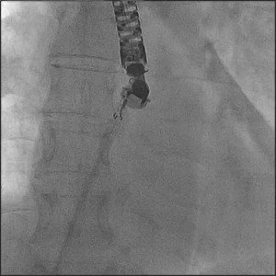
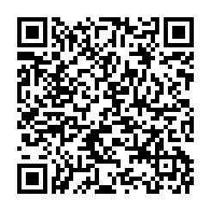
Atrial septal defect and patent foramen ovale closure
MOVING IMAGE 7-7-1
Opening of the LA disc in LA near LUPV – fluoroscopic view.
Jochen Wöhrle, Julia Seeger
©2025 Europa Group - All rights reserved.

