Slide 1


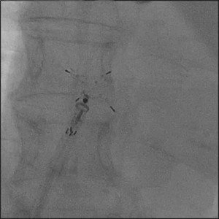

Atrial septal defect and patent foramen ovale closure
MOVING IMAGE 7-8-1
The LA disc is nicely attached to the atrial septum. The RA disc is delivered by retracting the delivery sheath while the device is kept stable in position.
Jochen Wöhrle, Julia Seeger
©2025 Europa Group - All rights reserved.

