Slide 1


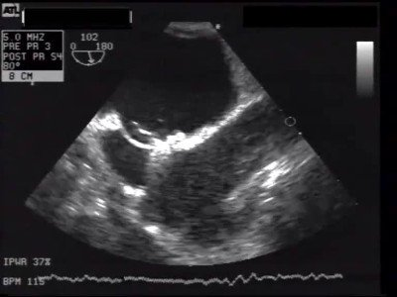

Atrial septal defect and patent foramen ovale closure
MOVING IMAGE 7-8-2
TEE view of RA disc delivery. The occluder nicely covers the atrial septum.
Jochen Wöhrle, Julia Seeger
©2025 Europa Group - All rights reserved.

