Slide 1


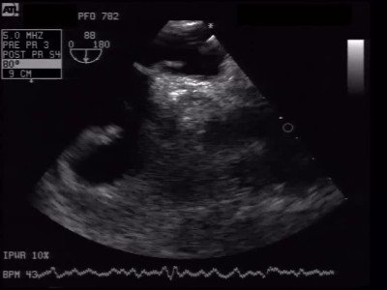

Atrial septal defect and patent foramen ovale closure
MOVING IMAGE 8-1
TEE demonstrates PFO with 11 mm tunnel length. The guidewire for occluder implantation is already placed in LUPV and opens the PFO.
Jochen Wöhrle, Julia Seeger
©2025 Europa Group - All rights reserved.

