Slide 1


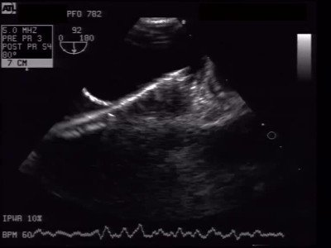

Atrial septal defect and patent foramen ovale closure
MOVING IMAGE 8-2
The delivery sheath is placed in body of LA. Withdrawal of the delivery sheath opens the LA disc with the low-profile Nitinol anchors of the Premere PFO Closure System.
Jochen Wöhrle, Julia Seeger
©2025 Europa Group - All rights reserved.

