Slide 1


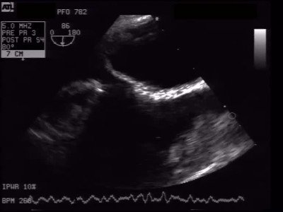
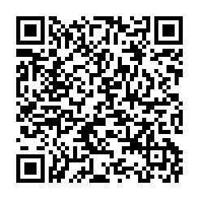
Atrial septal defect and patent foramen ovale closure
MOVING IMAGE 8-3
The LA disc is connected to a tether and nicely attached to the left side of the atrial septum. The right anchor slides over this tether towards the left anchor enabling the device to adapt to varying septal anatomies and tunnel lengths.
Jochen Wöhrle, Julia Seeger
©2025 Europa Group - All rights reserved.

