Slide 1


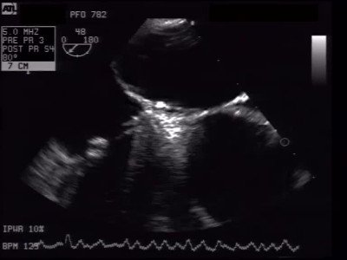

Atrial septal defect and patent foramen ovale closure
MOVING IMAGE 8-4
Both discs are delivered. Due to the flexible tether, there is no tension on the system and the final position can be evaluated.
Jochen Wöhrle, Julia Seeger
©2025 Europa Group - All rights reserved.

