Slide 1


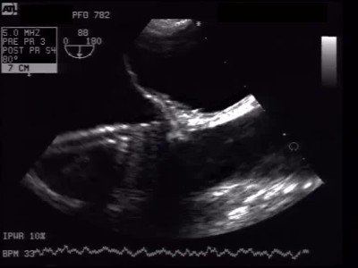
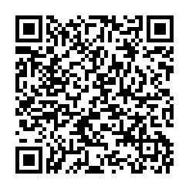
Atrial septal defect and patent foramen ovale closure
MOVING IMAGE 8-5
The delivery sheath is advanced to the device and the tether is cut.
Jochen Wöhrle, Julia Seeger
©2025 Europa Group - All rights reserved.

