Slide 1


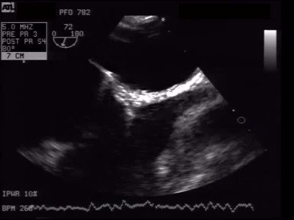
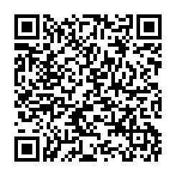
Atrial septal defect and patent foramen ovale closure
MOVING IMAGE 8-6
No bubble passage after device implantation in TEE with Valsalva manoeuvre.
Jochen Wöhrle, Julia Seeger
©2025 Europa Group - All rights reserved.

