Slide 1


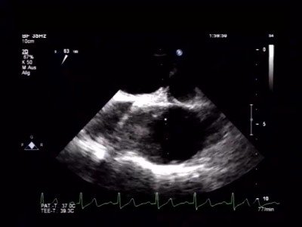
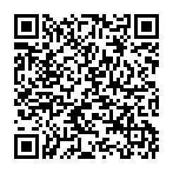
Atrial septal defect and patent foramen ovale closure
MOVING IMAGE 8-7
TEE 3 months after device implantation shows a perfect result without bubble passage.
Jochen Wöhrle, Julia Seeger
©2025 Europa Group - All rights reserved.

