Slide 1


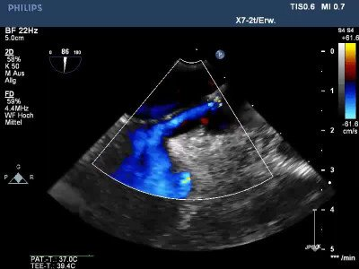

Atrial septal defect and patent foramen ovale closure
MOVING IMAGE 9-1
TEE demonstrates a PFO. After guidewire implantation there is a continuous shunt in Colour Doppler.
Jochen Wöhrle, Julia Seeger
©2025 Europa Group - All rights reserved.

