Slide 1


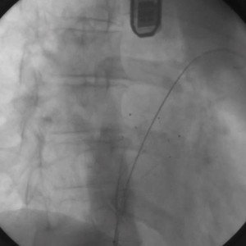
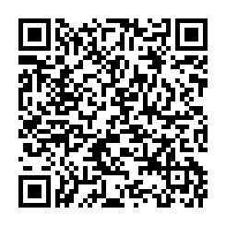
Atrial septal defect and patent foramen ovale closure
MOVING IMAGE 9-2
Over the stiff guidewire in the LUPV the intra-tunnel device FlatStent (Coherex Medical, Salt Lake City, UT, USA) was implanted without a delivery sheath. This eliminates the possibility of air embolism. The stable position of the device is tested.
Jochen Wöhrle, Julia Seeger
©2025 Europa Group - All rights reserved.

