Slide 1


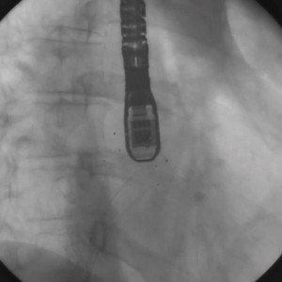
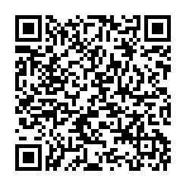
Atrial septal defect and patent foramen ovale closure
MOVING IMAGE 9-3
The guidewire was retrieved. The device is released.
Jochen Wöhrle, Julia Seeger
©2025 Europa Group - All rights reserved.

