Slide 1


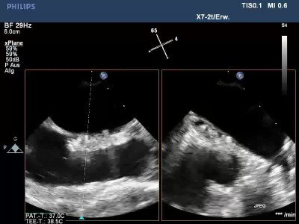

Atrial septal defect and patent foramen ovale closure
MOVING IMAGE 9-4
Final result in x-plane TEE demonstrates the position within the PFO.
Jochen Wöhrle, Julia Seeger
©2025 Europa Group - All rights reserved.

