Slide 1


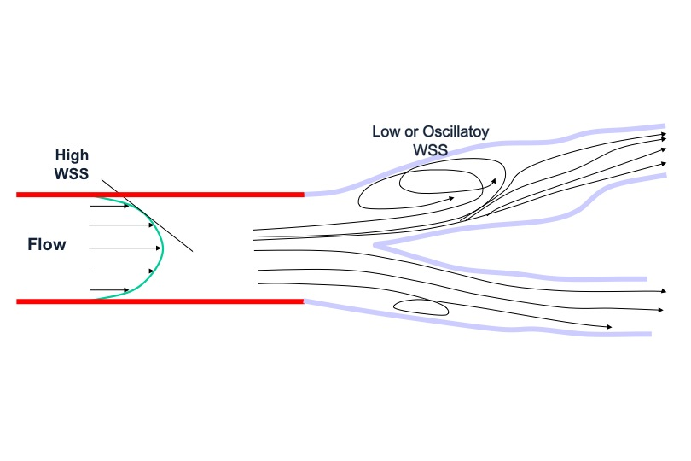

Bifurcation lesions (old)
Figure 1
Characteristics of flow in bifurcations (adapted from Chatzisisis)
Thierry Lefèvre, Thomas Hovasse
©2025 Europa Group - All rights reserved.

