Slide 1


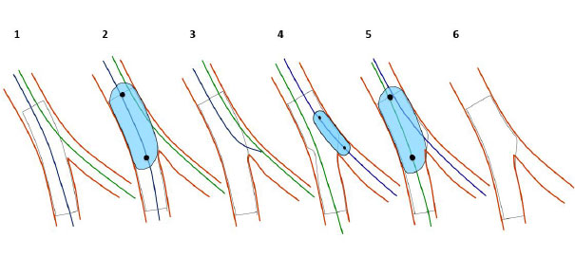

Bifurcation lesions (old)
Figure 10
POT/Side/POT technique (RePOT): 1. stent deployment (diameter selected according to the MB distal reference. 2. Proximal optimization technique. 3. SB wiring through a distal strut. 4. SB dilatation with a NC balloon. 5. RePOT to correct the MB stent deformation. 6. Final result.
Thierry Lefèvre, Thomas Hovasse
©2025 Europa Group - All rights reserved.

