Slide 1


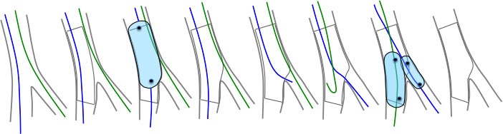
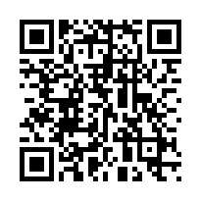
Bifurcation lesions (old)
Figure 12
Schematic drawings illustrating provisional bifurcation stenting with the proximal optimisation technique (POT) and final kissing balloon inflation (FKB). Of note the jailed side branch and main branch wires are swapped over after the POT.
Thierry Lefèvre, Thomas Hovasse
©2025 Europa Group - All rights reserved.

