Slide 1


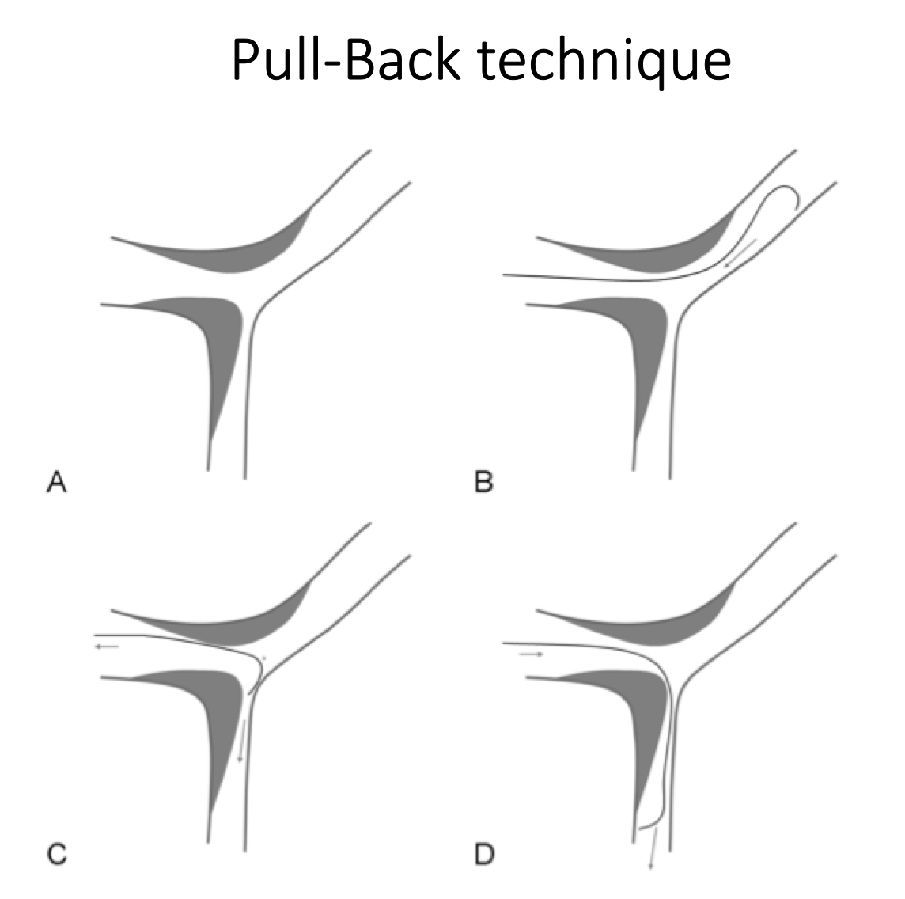
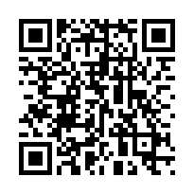
Bifurcation lesions (old)
Figure 13
Schematic drawings of the «Pull-back technique» in case of difficult side branch access.
Thierry Lefèvre, Thomas Hovasse
©2025 Europa Group - All rights reserved.

