Slide 1


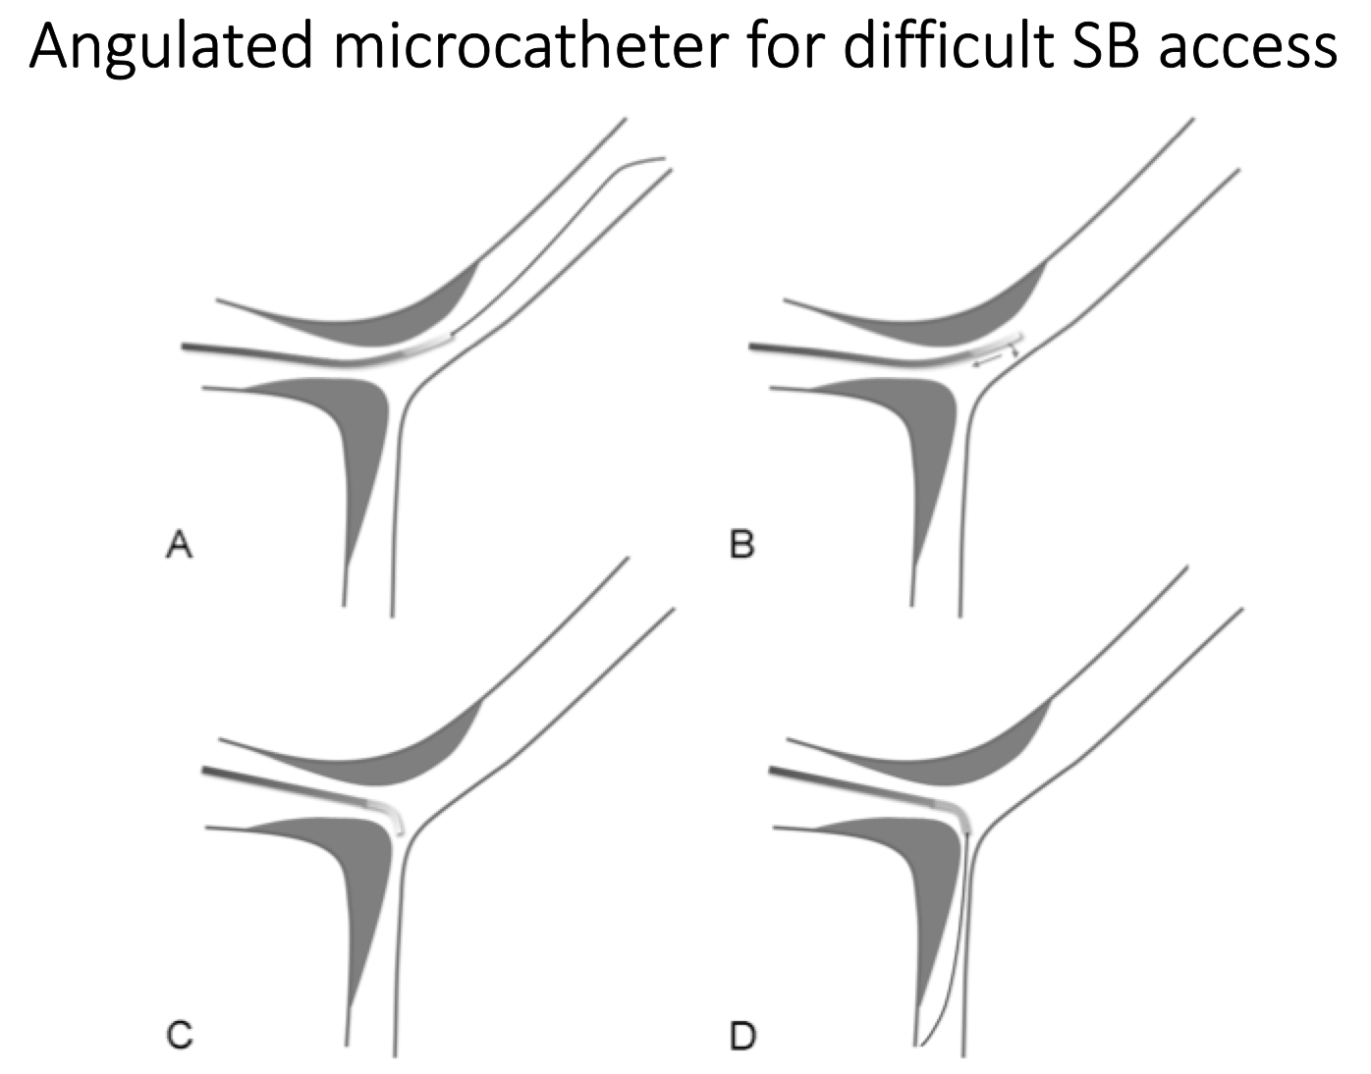

Bifurcation lesions (old)
Figure 14
Schematic drawings of the angulated microcatheter approach in case of impossible side branch access.
Thierry Lefèvre, Thomas Hovasse
©2025 Europa Group - All rights reserved.

