Slide 1


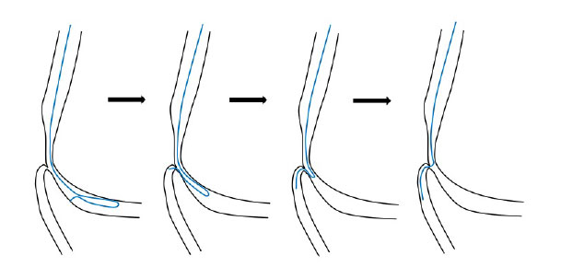

Bifurcation lesions (old)
Figure 15
Schematic drawings illustrating the reversed wire technique. This is one of several advanced wire techniques that may be used for traversing an extremely angulated side branch origin.
Thierry Lefèvre, Thomas Hovasse
©2025 Europa Group - All rights reserved.

