Slide 1


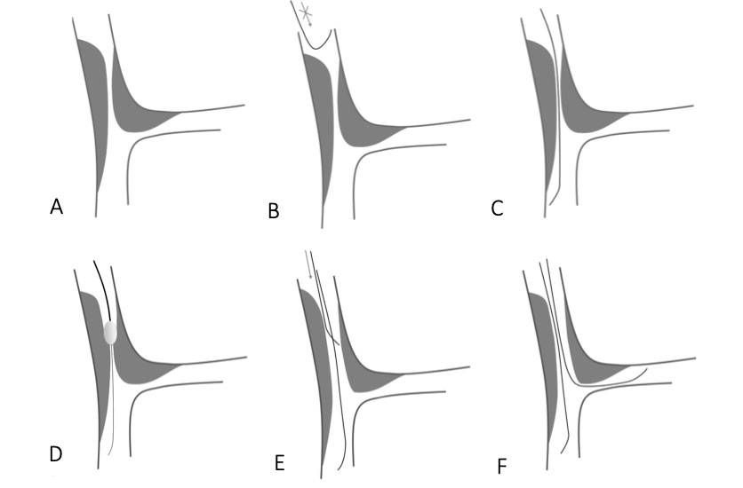

Bifurcation lesions (old)
Figure 16
Schematic drawings illustrating the role of Rotablator to facilitate difficult side branch access.
Thierry Lefèvre, Thomas Hovasse
©2025 Europa Group - All rights reserved.

