Slide 1


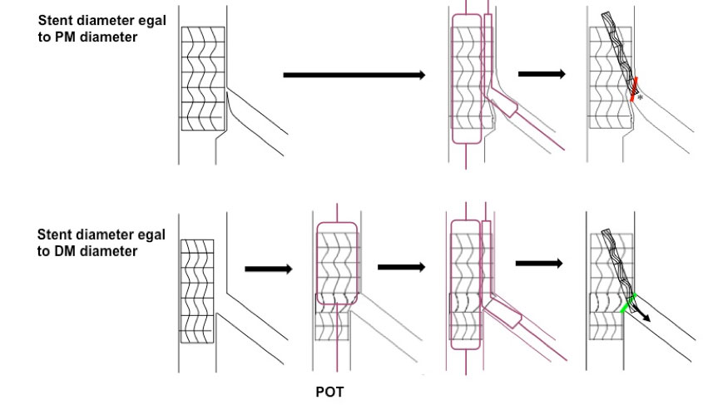

Bifurcation lesions (old)
Figure 18
The crucial role of stent diameter Upper panel: Schematic illustrating the effect of sizing the MB stent to its proximal diameter with subsequent carina shift and more challenging entry for equipment into the SB. Lower panel: Schematic illustrating the effect of sizing the MB stent to its distal diameter with subsequent preservation of the carina and ostial SB anatomy thus allowing easier access to the SB.
Thierry Lefèvre, Thomas Hovasse
©2025 Europa Group - All rights reserved.

