Slide 1


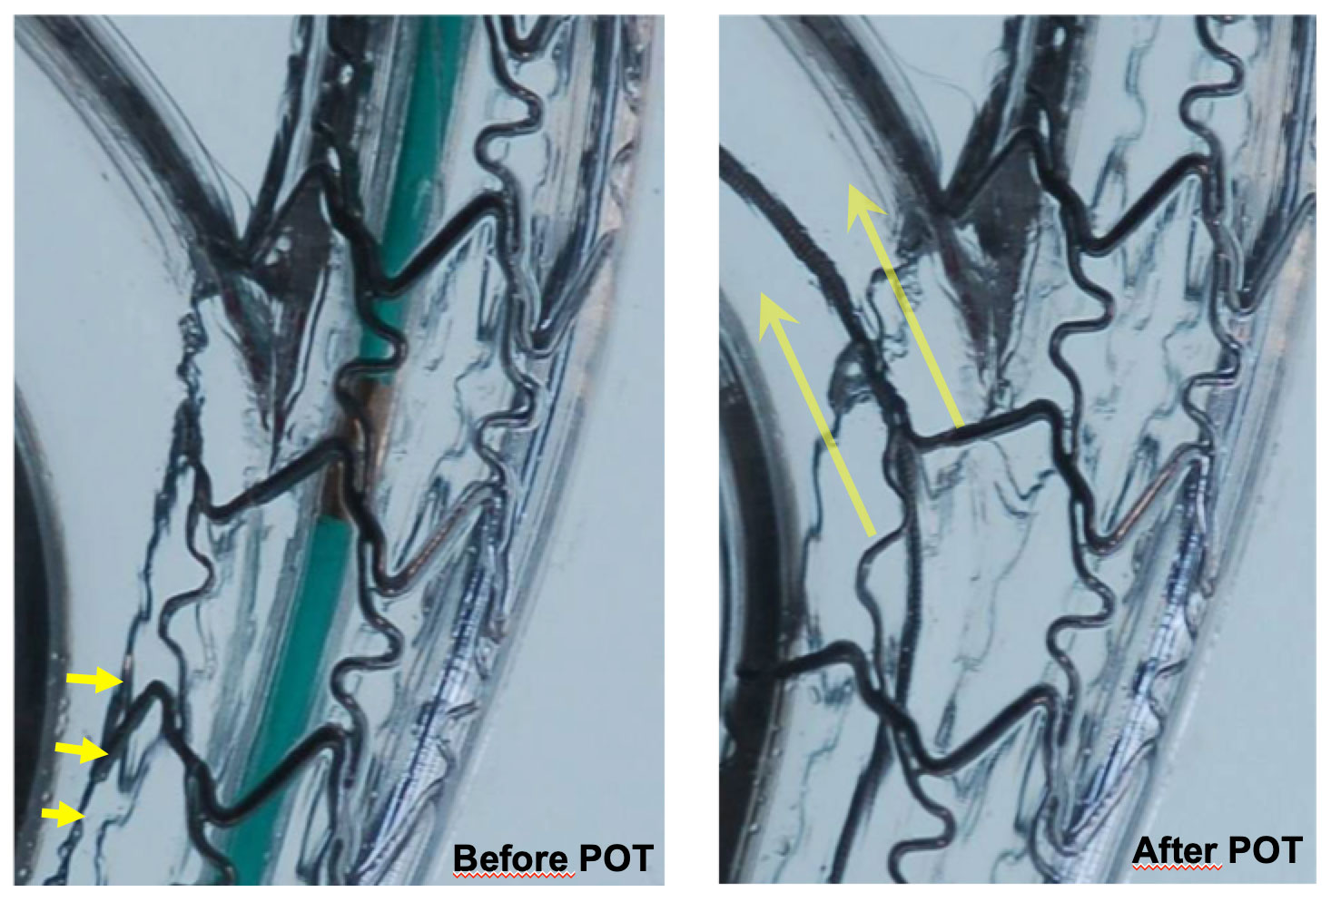

Bifurcation lesions (old)
Figure 19
Role of POT Virtual bench simulation of provisional bifurcation stenting showing the improvement in stent apposition [yellow arrow] and enlargement in cell area across the SB by use of the proximal optimisation technique.
Thierry Lefèvre, Thomas Hovasse
©2025 Europa Group - All rights reserved.

