Slide 1


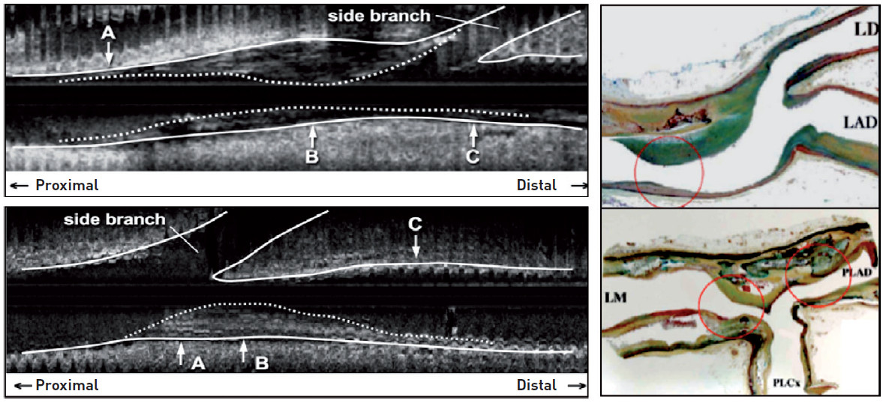

Bifurcation lesions (old)
Figure 2
No atheroma at the level of the carena in the majority of cases Atheroma is developing in areas of low shear, opposite to the flow divider (adapted from Shimada and Virmani)
Thierry Lefèvre, Thomas Hovasse
©2025 Europa Group - All rights reserved.

